Slide 1

The effect of: Temperature
Nick Deitmers

Slide 2
Effect of
Suicide
GDP
AVG Temperature
per year
per country
in C*

Slide 3
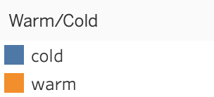
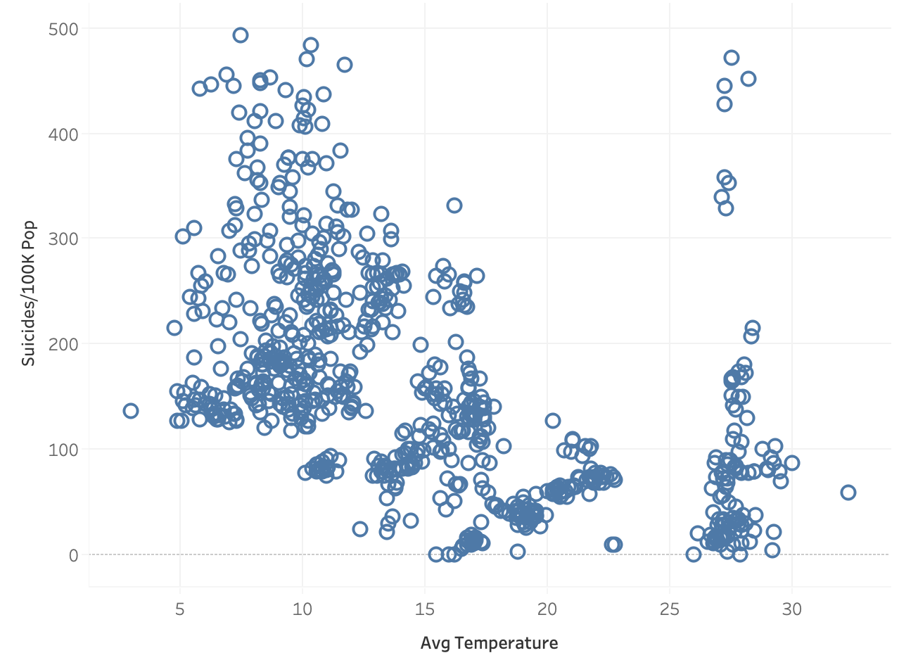
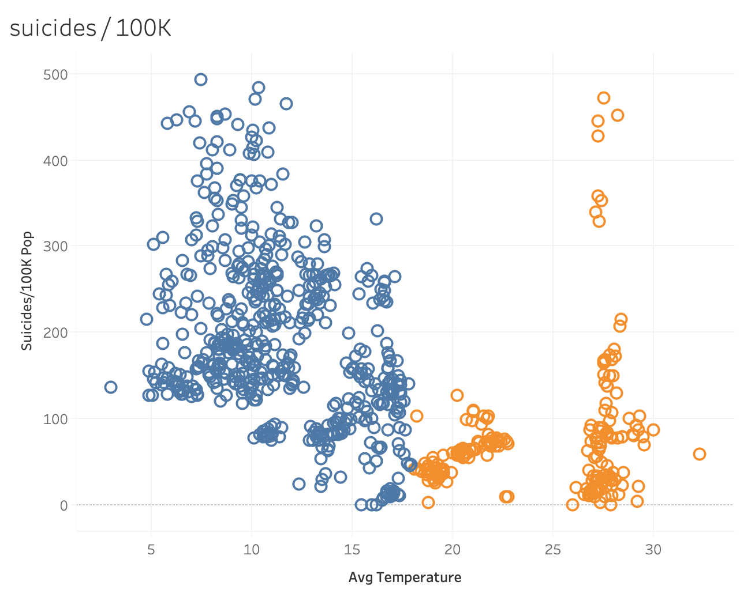
Suicides per 100K
Spearman corr:
-0.61
Moderate negative correlation
Notes:
Consider talking about:
Kinetic theory of gases
Zeroth law of thermodynamics
Second law of thermodynamics
Definition from statistical mechanics
Generalized temperature from single-particle statistics
Negative temperature

Slide 4
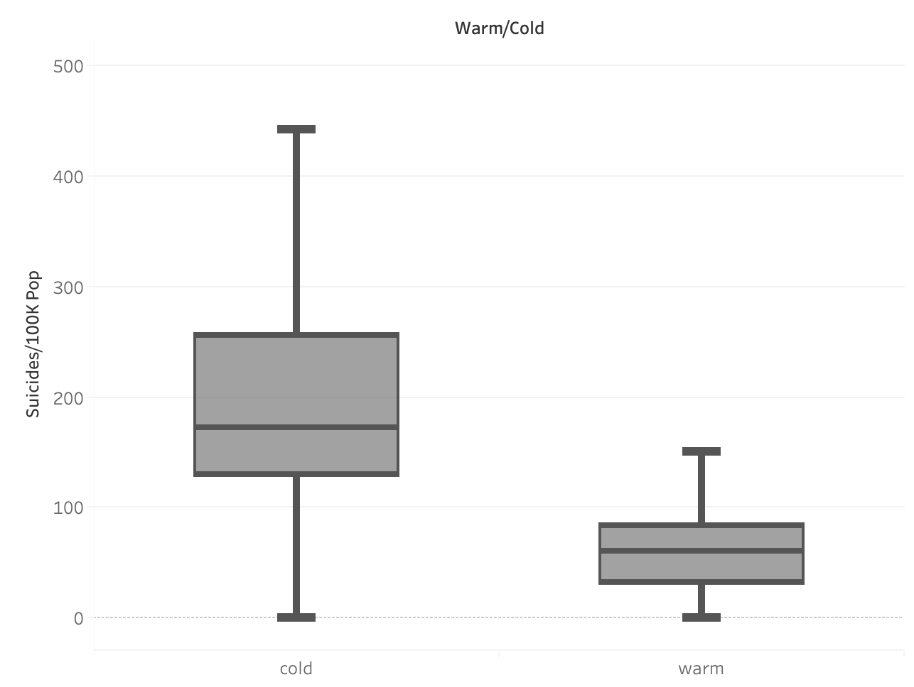
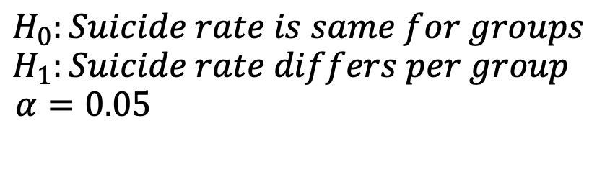
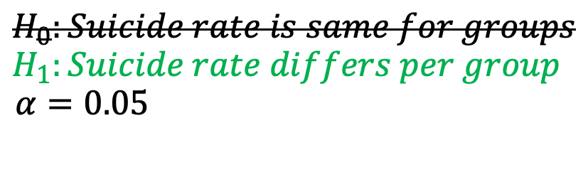
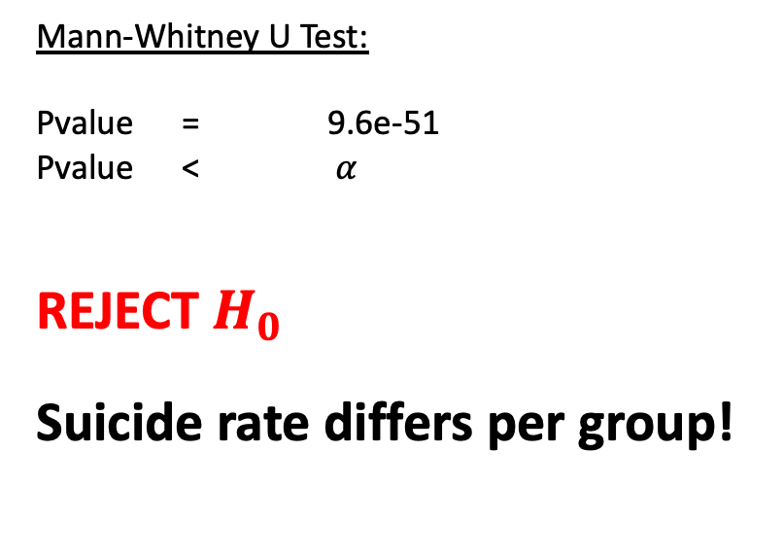
Suicides per 100K
$$H_{0}:Suicide rate is same for groups$$
$$H_{1}:Suicide rate differs per group$$
$$α=0.05$$
$$H_{0}:Suicide rate is same for groups$$
$$H_{1}:Suicide rate differs per group$$
$$α=0.05$$
Mann-Whitney U Test:
Pvalue = 9.6e-51
Pvalue < $α$
REJECT $H_{0}$
Suicide rate differs per group!
COLD
WARM

Slide 5
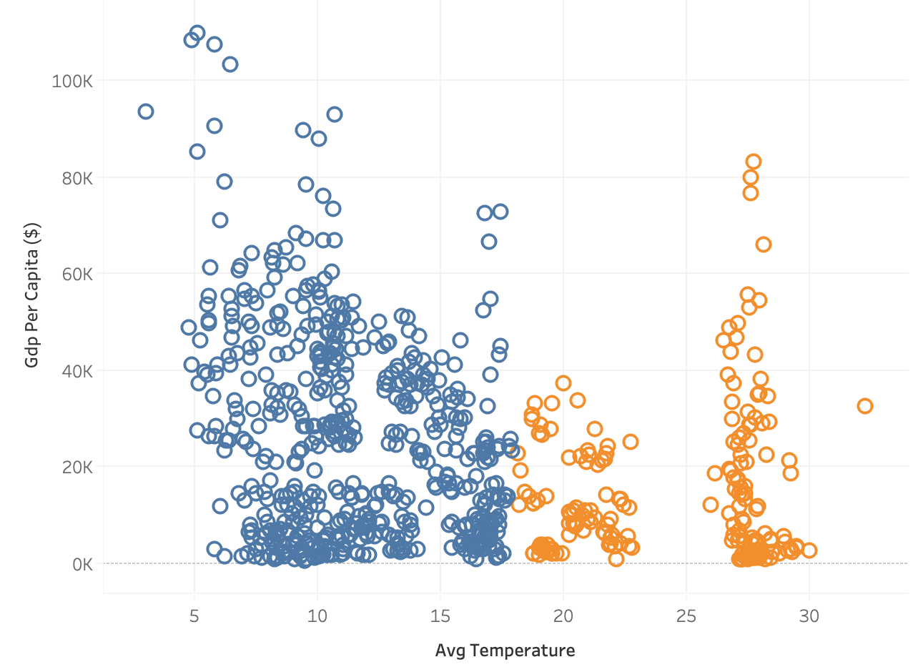
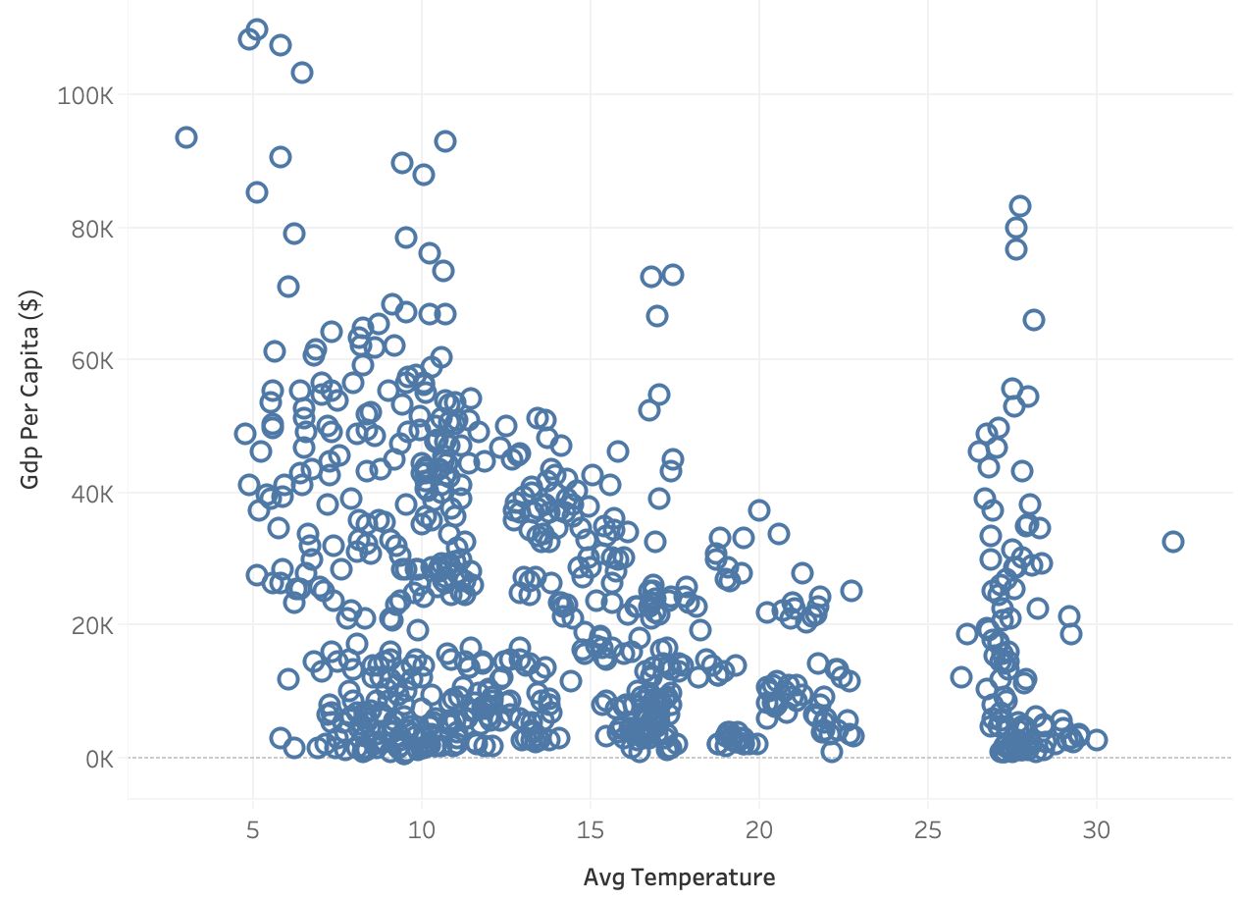
Gross Domestic Product per capita
Spearman corr:
-0.29
No real
correlation
Notes:
Consider talking about:
Kinetic theory of gases
Zeroth law of thermodynamics
Second law of thermodynamics
Definition from statistical mechanics
Generalized temperature from single-particle statistics
Negative temperature

Slide 6
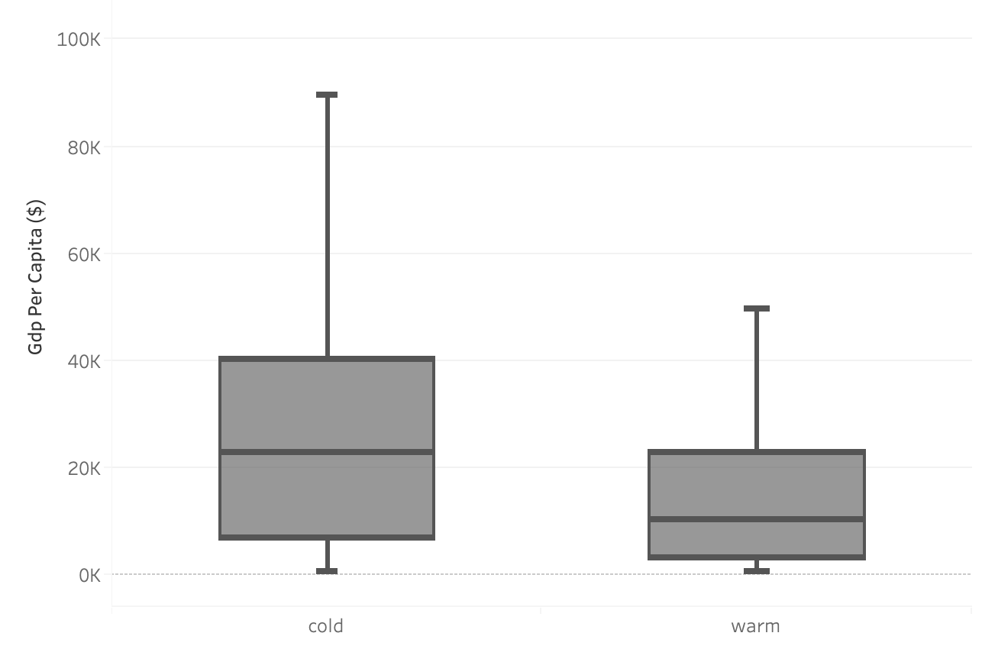
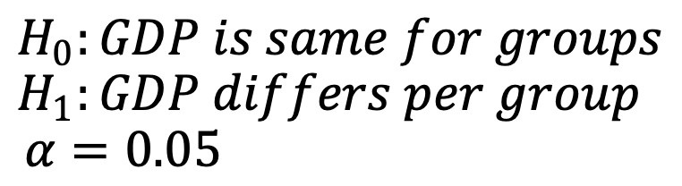

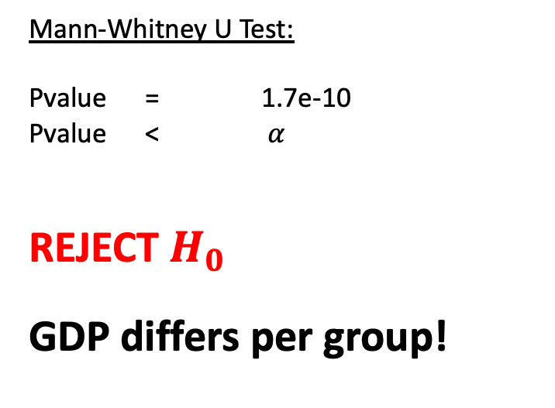
Gross Domestic Product per capita
$$H_{0}:GDP is same for groups$$
$$H_{1}:GDP differs per group$$
$$α=0.05$$
$$H_{0}:GDP is same for groups$$
$$H_{1}:GDP differs per group$$
$$α=0.05$$
Mann-Whitney U Test:
Pvalue = 1.7e-10
Pvalue < $α$
REJECT $H_{0}$
GDP differs per group!
COLD
WARM

Slide 7

Conclusion
The suicide rate is lower in ‘warm’ countries
The GDP per capita is lower in ‘warm’ countries

Slide 8
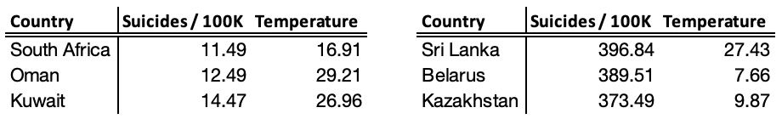
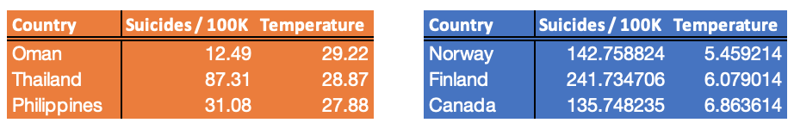
Top 3 suicides
Top 3 temperature

